Slide 1
Chapter 1 Git, GitHub and Markdown

Slide 2
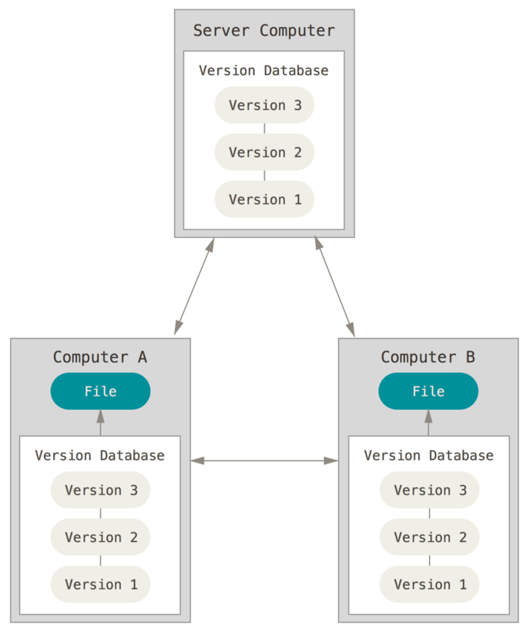
Git
Git is a free and open source distributed version control system.
Version control is a system that records changes to a file or set of files over time so that you can recall specific versions later.
A Git repository stores all versions of the files in your project.
Figure. Distributed Version Control
Notes:
Figure 3, Scott Chacon and Ben Straub, Pro Git, 2nd Ed. https://git-scm.com/book/en/v2.

Slide 3
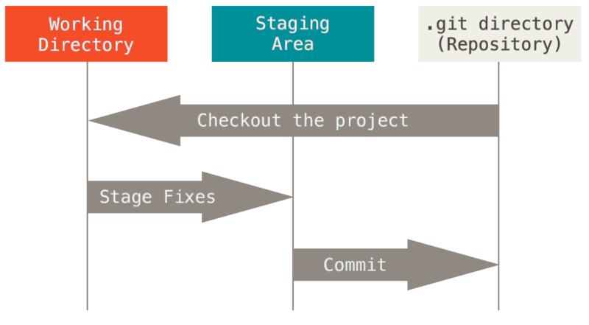
Basic Git Workflow
Modify a file in a working directory.
Add the changes to the staging area.
Do a commit to store the snapshot permanently to your repository.
Notes:
Figure 6, Scott Chacon and Ben Straub, Pro Git, 2nd Ed. https://git-scm.com/book/en/v2.

Slide 4
GitHub
GitHub is a web-based hosting service for Git repositories.
GitHub has become a leading software development platform and a social networking site for developers.

Slide 5
Terminology
A Git repository (repo) is a folder that helps you track file changes.
A branch is an independent line of development.
Master is the default development branch.
A fork is a personal copy of another user’s repository.
A clone is simply a copy of a repository that lives on your computer.
A commit is a set of one or more changes to files.

Slide 6
Git Bash Commands
# change to home directory
$ cd ~
# create a folder
$ mkdir <folder name>
# print current directory
$ pwd
# list contents of a directory
$ ls -a

Slide 7
Git Bash Commands (cont’d)
# change to another directory
$ cd <directory name>
# insert a string into a text file
$ echo “text” >> <filename>
# display contents of a text file
$ cat <filename>
# copy a file
$ cp <src> <dst>
# move a file
$ mv <src> <dst>
# delete a file
$ rm <filename>

Slide 8
Git Configuration
# your name
$ git config --global user.name “yourname”
# your email
$ git config --global user.email “your email”
# automatic command line coloring
$ git config --global color.ui auto
# list all current configuration settings
$ git config --list

Slide 9
Git Commands: Basics
# create a new repo
$ git init
# check working directory changes
$ git status
# move changes to the staging area
$ git add *
# view changes not yet staged
$ git diff <filename>
# view changes in the staging area and the last commit
$ git diff --cached <filename>
# commit changes to the repository
$ git commit -m “commit message”

Slide 10
Git Commands: Undoing Changes at the File-level
# show history of commits
$ git log --oneline --all
# undo unstaged changes to a file
$ git checkout <filename>
# undo staged changes to a file
$ git reset <filename>
# check out content from the depository and put it in the working tree
$ git checkout <commit hash> <filename>

Slide 11
Git Commands: Undoing Changes at the Commit-level
# no update of the commit history
# switch to a specified commit
$ git checkout <commit hash>
# switch backward by two commits
$ git checkout HEAD~2
# discard commits
# discard the most recent commit
$ git reset HEAD~ --soft (--hard, or --mixed)
# discard the commits since the specified commit
$ git reset <commit hash>
# Undo a commit by creating a new commit
$ git revert HEAD~ --no-edit
$ git revert <commit hash> --no-edit

Slide 12
Git Commands: Branching and Merging
# create a branch
$ git branch <branch name>
# list local branches
$ git branch
# list all branches
$ git branch --all
# switch to a branch
$ git checkout <branch name>
# merge from branch
$ git merge <branch name>
# delete a branch
$ git branch -d <branch name>

Slide 13
Git Commands: Hosting Projects on GitHub
# copy the contents of an existing GitHub repo
$ git clone <URL of the repo>
# add a remote repo
$ git remote add <repo name> <URL of the repo>
# remove a remote repo
$ git remote rm <repo name>
# update the local copy of a remote repo
$ git pull <repo name> <branch name> --allow-unrelated-histories --no-edit
# list remote repositories/branches
$ git remote --verbose
$ git remote show <repo name>
$ git branch --remote
# push new version on GitHub
$ git push <repo name> <branch name>

Slide 14
Markdown
Markdown is a text-to-HTML conversion tool.
Plain text
Punctuation characters used to format text
Markdown is supported by GitHub and Jupyter Notebook.
It is recommended that a README.md file is contained on each GitHub page.

Slide 15
Markdown Syntax – Text Styles
Headers
# H1
## H2
Emphasis
*italics*
-italics_
**bold**
_ _bold_ _
**bold and _italics_**
~~strike through~~

Slide 16
Markdown Syntax: Lists
Ordered list
1. First ordered list item
2. Second ordered list item
Unordered list
* An unordered list item
* Another unordered list item
Nested list
1. First ordered list item
2. Second ordered list item
* Unordered sub-list
3. Third ordered list item
1. Ordered sub-list

Slide 17
Markdown Syntax: Links and Code
Links
[I am an inline-style link](https://www.google.com)
[I am a relative reference to a repository file](https://gihub.com/.../)
Code and Syntax Highlighting
Inline `code` has `back-ticks around it`
Code blocks are fenced by three back-ticks ```
For instance,
```python
S = “python syntax highlighting”
```

